Slide 1
?

Slide 7
HINT
Stretching almost 400 miles from the city of London to the heart of the Scottish capital, this road connects two nations and passes through 18 counties. It's an unrivaled highway used by hundreds of thousands of vehicles every day.

Slide 8
The A1 , Britain's longest road
Indi Boțoc 2020

Slide 9
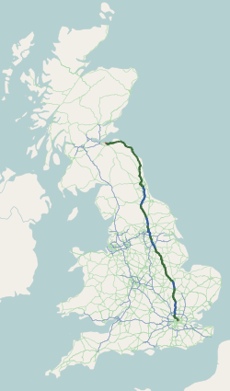
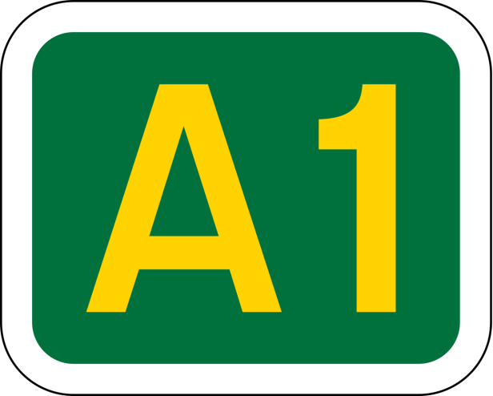

Slide 10
The A1 runs from New Change in the City of London at St. Paul's Cathedral to the centre of Edinburgh. The road skirts the remains of Sherwood Forest, and passes Catterick Garrison (largest British Army garrison in the world).

Slide 11
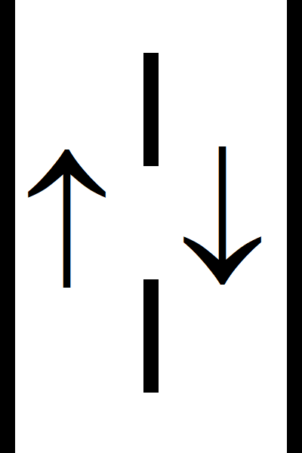
Single carriageway

Slide 12
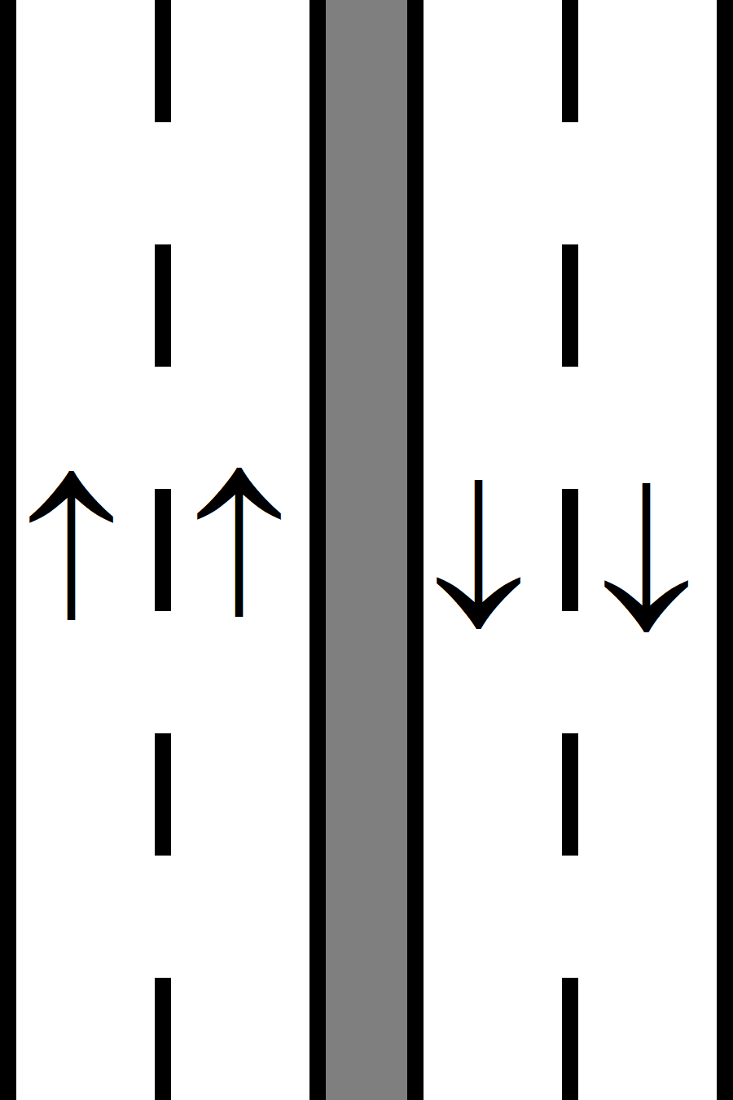
Dual carriageway

Slide 13
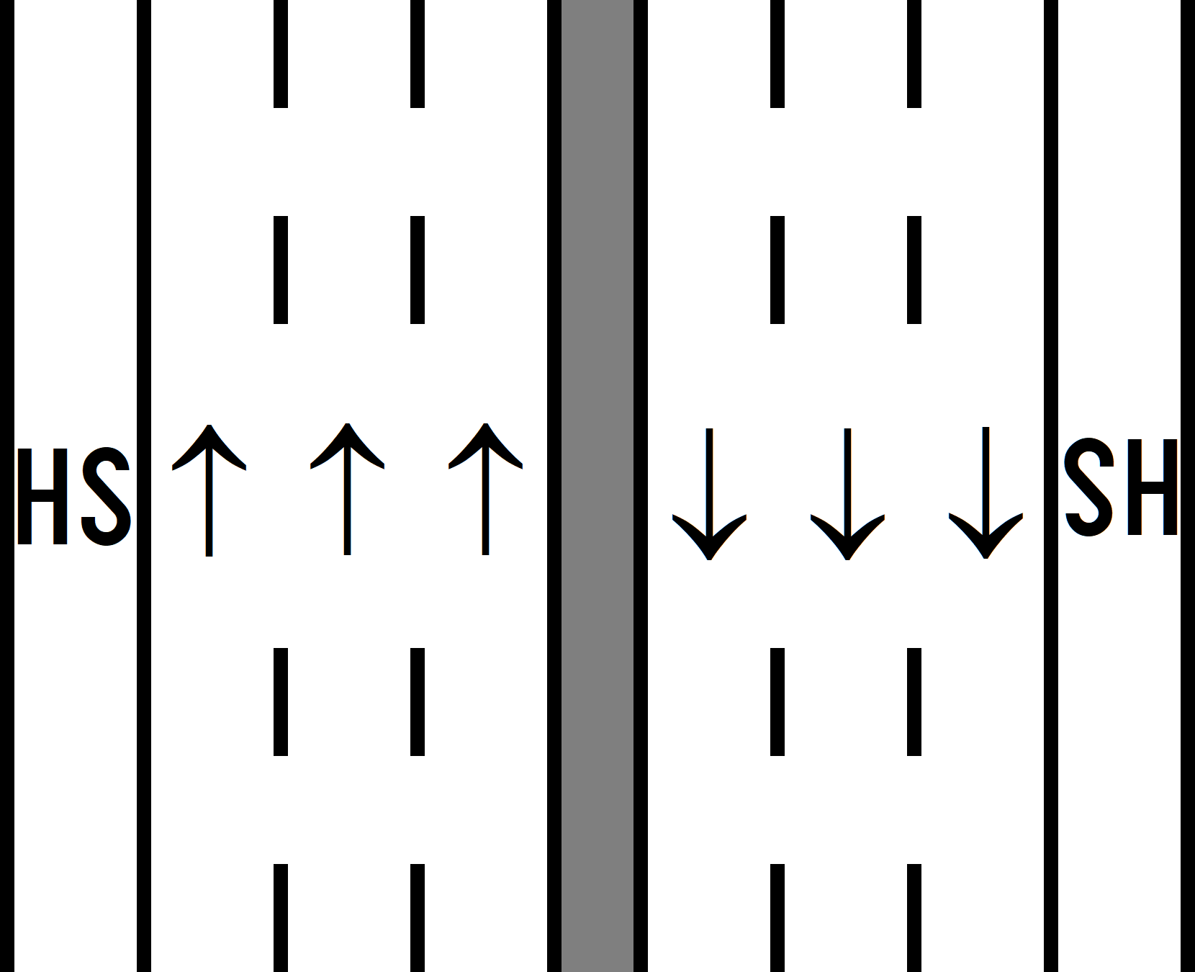
Motorway

Slide 14
I want to develop this topic because I think that roads, and also transport in general, are very important for the economy of every country. Therefore, I’ve chosen A1 because it is probably the most varied and fascinating route on the Motorway Database. There are, if you're sufficiently interested, whole books and websites exclusively about the A1's history and place in British culture. In terms of highway engineering this variety translates into inconsistency, running the whole way from the single-carriageway rural highway along the Scottish coast to the choked dual carriageway of the Newcastle Western Bypass and the eerily quiet eight-lane motorway across the Cambridgeshire countryside.

Slide 15
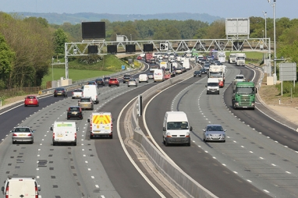
A1(M) near Cambridge

Slide 16
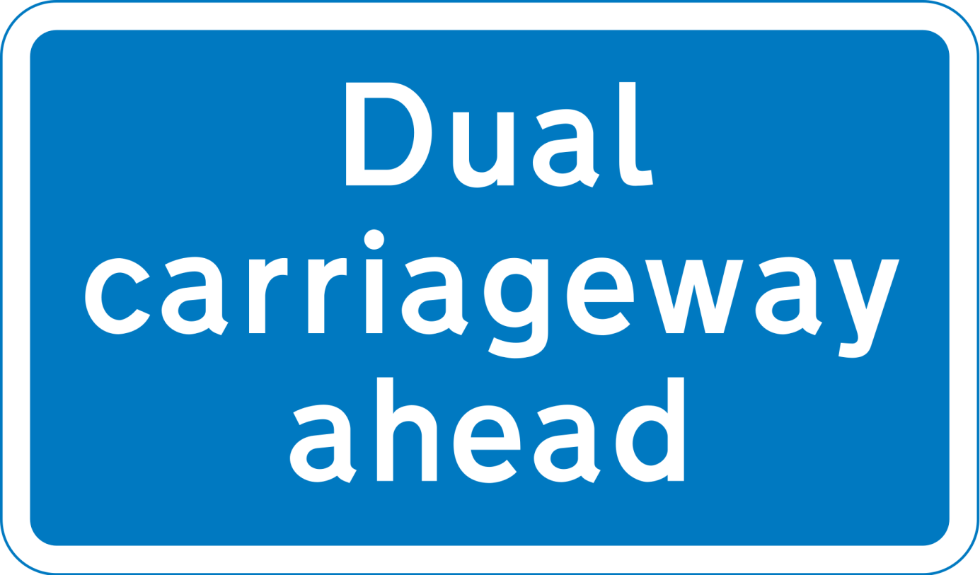

Slide 17
It was designated by the Ministry of Transport in 1921, and for much of its route it followed various parts of the historic Great North Road, the main deviation being in New Yorkshire region. The course of the A1 has changed where towns or villages have been bypassed, and where new alignements have taken a slightly different route. Several sections of the route have been upgraded to motorway standard and designated A1(M). Between the M25 (near London) and the A696 (near Newcastle upon Tyne) the road has been designated as part of the unsigned Euroroute E15 from Northern Scotland to Southern Spain.

Slide 18
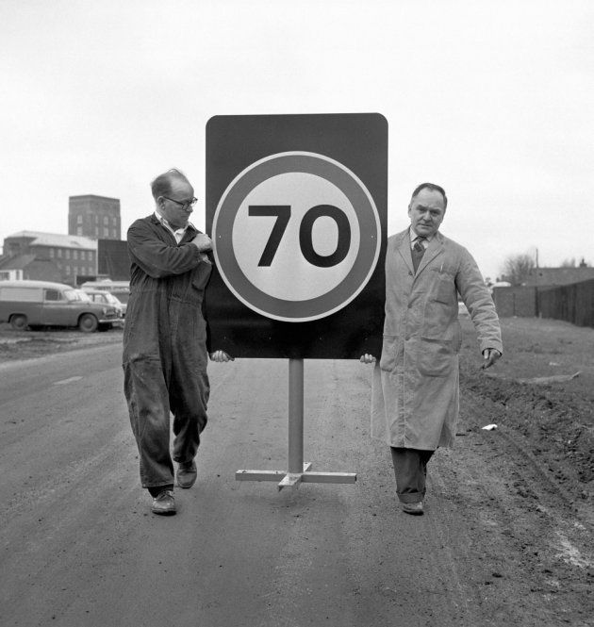
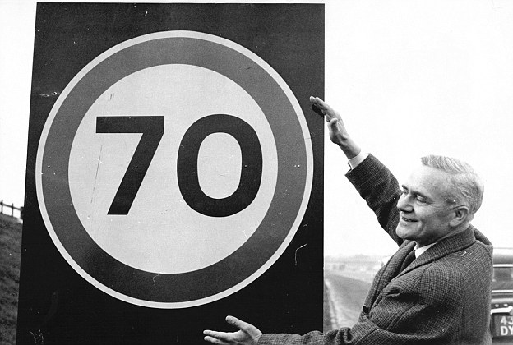
Harold Wilson, former British prime-minister
“On 22 December 1965, with the best of Government intentions, British motorists found themselves under a blanket 70mph speed limit on all roads without an existing lower limit.”

Slide 20
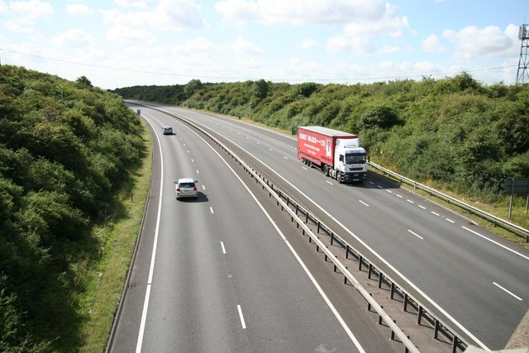
A1 near Stamford, Lincolnshire

Slide 21
The inns on the road, many of which still survive, were staging posts on the coach routes, providing accommodation, stabling for the horses and replacement mounts. Few of the surviving coaching inns can be seen while driving on the A1, because the modern route now bypasses the towns with the inns.
Scotch Corner, in North Yorkshire, marks the point where before the M6 was built the traffic for Glasgow and the west of Scotland diverged from that for Edinburgh. As well as a hotel there have been a variety of sites for the transport café, now subsumed as a motorway services.

Slide 22
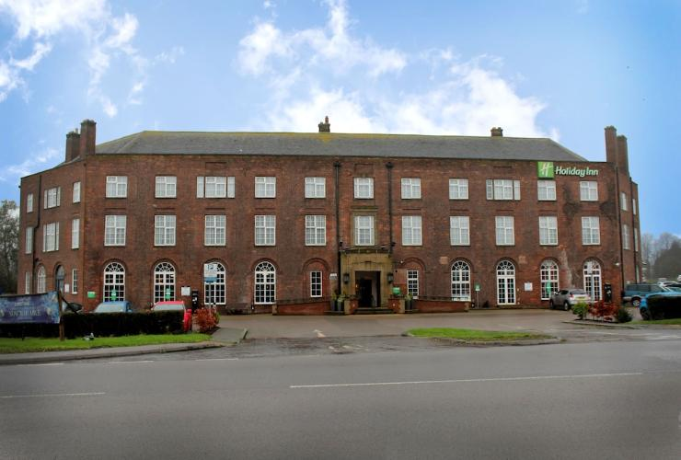
The Scotch Corner Hotel

Slide 23
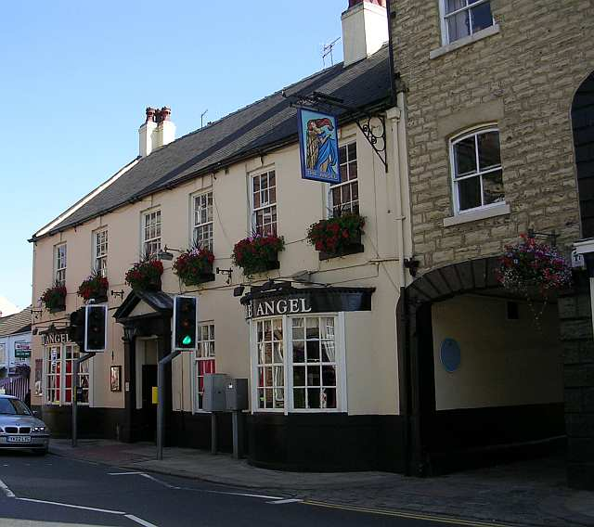
An old inn in West Yorkshire, on the former A1 road

Slide 24
Most of the English section of the A1 is a series of alternating sections of primary route, dual carriageway and motorway. From Newcastle upon Tyne to Edinburgh it is a trunk road with alternating sections of dual and single carriageway. The non-motorway sections do not have junction numbers.
Plans to dual the single carriageway section of road north of Newcastle upon Tyne were shelved in 2006 as they were not considered a regional priority by central government. The main road of the UK is not as important as ... the A1.

Slide 25
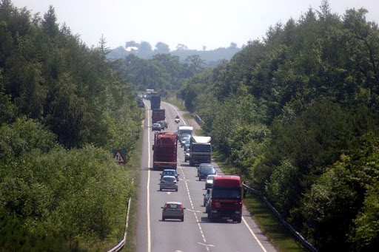
A1 near the border between England and Scotland

Slide 26
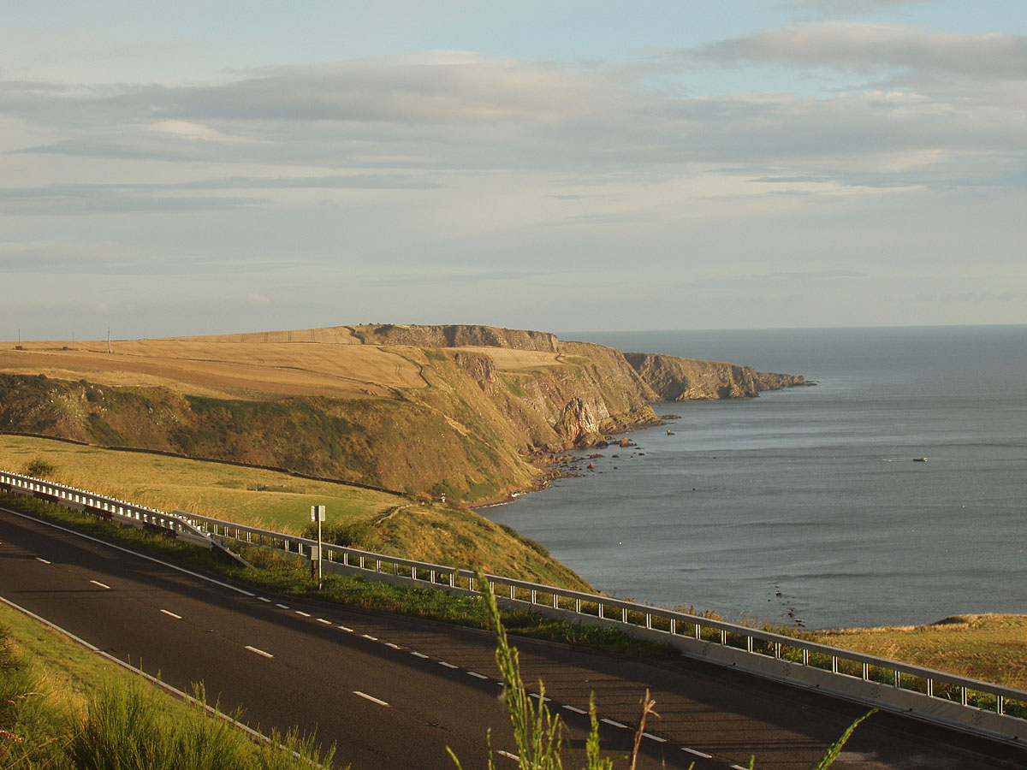
A1 near the North Sea (Scotland)

Slide 27
To sum up, there is no single identity to the A1, no one thing that you can say that describes the whole of it, except the glib* observation that it's incredibly varied and it always has been. And it's all the more wonderful and fascinating for it.
*) if you describe what someone says as glib, you disapprove of it because it implies that something is simple or easy, or that there are no problems involved, when this is not the case.

Slide 28
https://en.wikipedia.org/wiki/a1_road_(great_britain) https://en.wikipedia.org/wiki/a1(m)_motorway https://www.roads.org.uk/motorway/a1 https://www.youtube.com/watch?v=0waj6bdzuli https://www.youtube.com/watch?v=yhgjgp_hxog https://www.youtube.com/watch?v=upixshgrc4m https://www.youtube.com/watch?v=s6j3gmsy3fo https://www.youtube.com/watch?v=t5f9h8mdmem https://www.youtube.com/watch?v=6t9owcyschu https://en.wikipedia.org/wiki/catterick_garrison
T H A N K Y O U !

